Slide 1
Kyber
By Pakin Panawattanakul
24/03/2025

Slide 2
Presentation outline
Introduction
Objective
What is FPGA
Kyber PKE
Kyber KEM

Slide 3
Introduction

Slide 4
Objective
Our group previous presentation
Post quantum cryptography : variations, math problem, performance → Lattice based
Frodo KEM : Lattice based algorithm that haven’t been implement → It is suck !
Today Objective
AJ. Vasin : Find Lattice based cryptography implementation methods on FPGA
Understanding basic idea of Kyber-PKE & Kyber-KEM

Slide 5
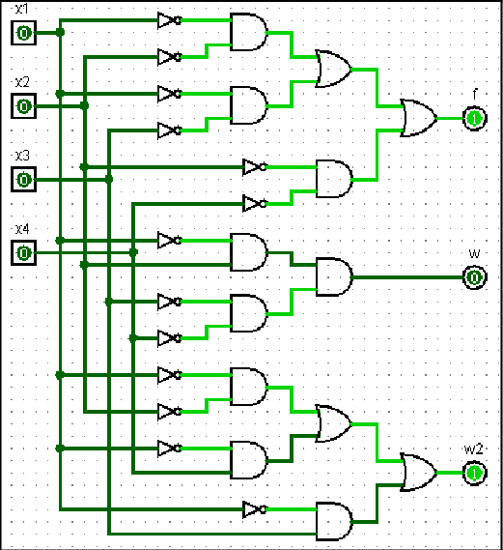
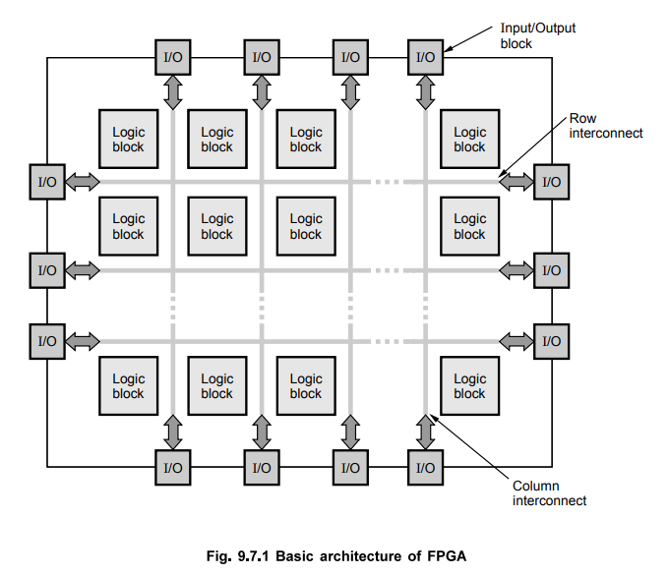
Field programmable gates array
No instruction set like traditional CPU
Reconfigurable Logic Block
Using Hardware description language
E.g. Verilog and VHDL
Parallel execution
Flexibility and Customizable
https://eee.poriyaan.in/topic/fpga--field-programmable-gate-arrays--11689/
https://www.researchgate.net/figure/Digital-circuit-with-two-inputs-OR-and-AND-gates_fig11_309907692

Slide 6
Kyber-pke & kyber-kem
Base on Module Learning with Error ( Tony’s presentation)
Kyber-KEM chosen to be standard Key encapsulation algorithm by NIST
NIST (National Institute of Standards and Technology) is a U.S. agency that develops and promotes standards for technology, including cybersecurity and cryptography.

Slide 7
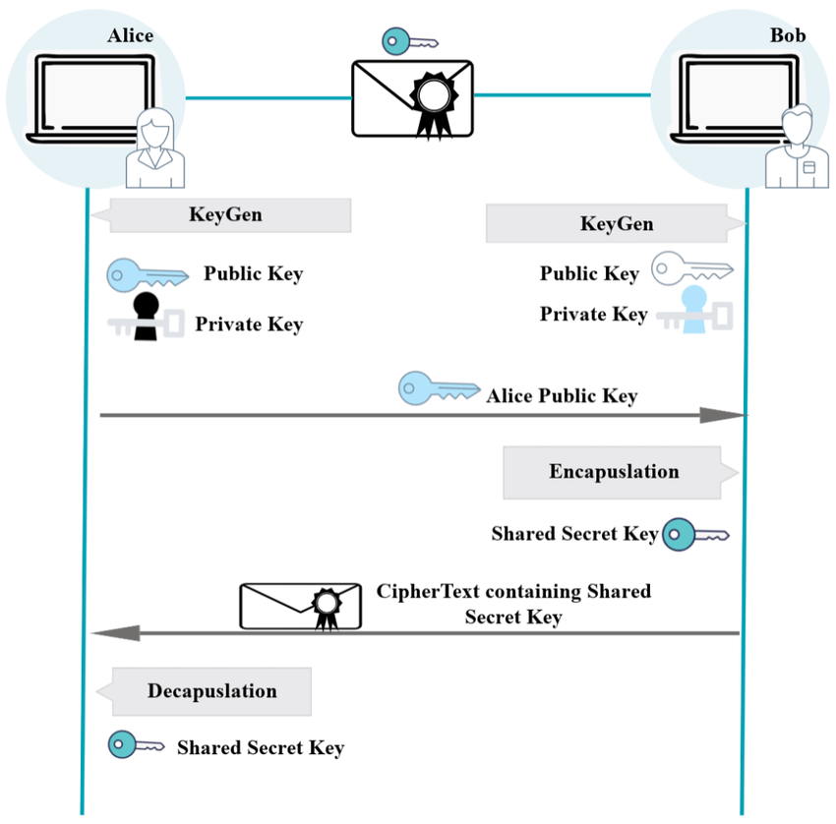
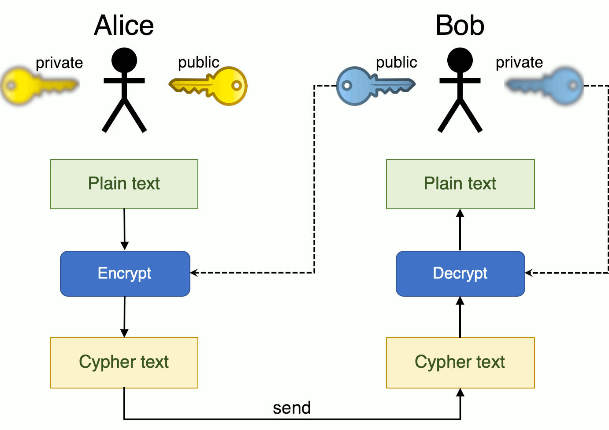
Public key encryption(PKE)
Encrypted message
Key Encapsulation Mechanism (KEM)
Established shared secret key (symmetric key)
https://www.coengoedegebure.com/surviving-an-infosec-job-interview-cryptography/
https://www.researchgate.net/publication/371388643_Resilience_Optimization_of_Post-Quantum_Cryptography_Key_Encapsulation_Algorithms

Slide 8

Important math notation
Integer modulo $ℤ_{q}$
Polynomial ring : $R_{q}=ℤ_{q}\left[x\right]/(x^{n}+1)$
Polynomial vector $R_{q}^{k}$
“ Small” Polynomial $: S_{η}$
bit string ${\left\{0,1\right\}}^{n}$

Slide 9
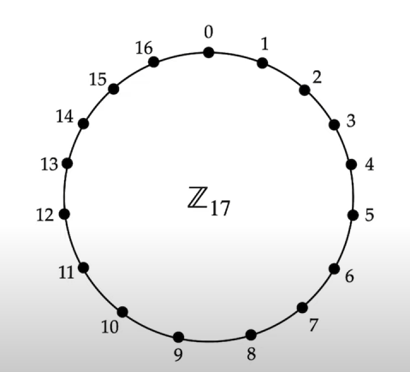


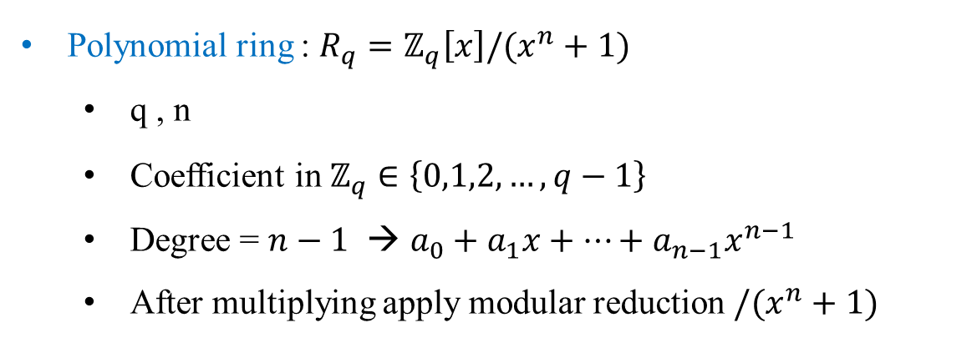
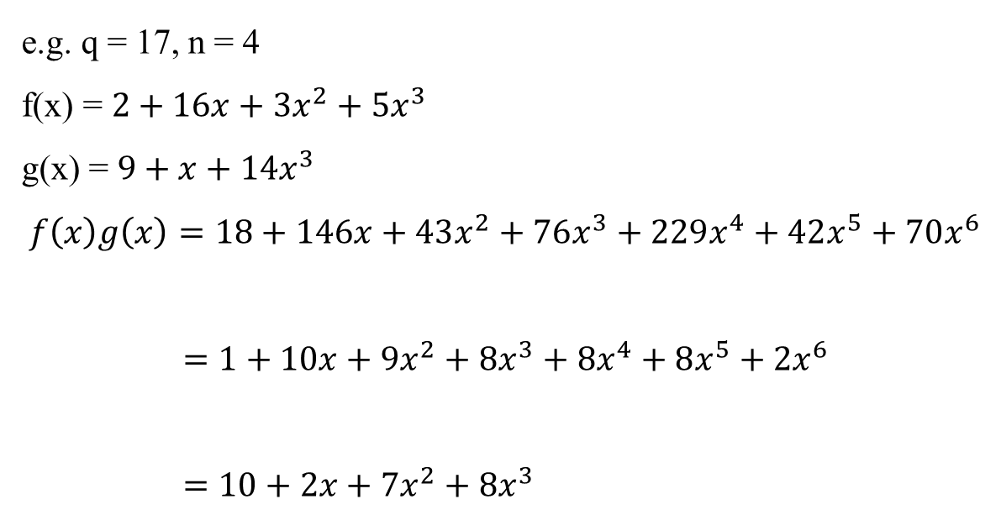
Integer modulo : $ℤ_{q}$
Integer 0,1,2,…, q-1
After math operation → mod q
e.g. 15+3 = 18%17 = 1
Polynomial ring : $R_{q}=ℤ_{q}\left[x\right]/(x^{n}+1)$
q , n
Coefficient in $ℤ_{q}∈\left\{0,1,2,…,q−1\right\}$
Degree = $n−1$ → $a_{0}+a_{1}x+…+a_{n−1}x^{n−1}$
After multiplying apply modular reduction $/(x^{n}+1)$
e.g. q = 17, n = 4
f(x) = $2+16x+3x^{2}+5x^{3}$
g(x) = $9+x+14x^{3}$
$$f\left(x\right)g\left(x\right)=18+146x+43x^{2}+76x^{3}+229x^{4}+42x^{5}+70x^{6}$$
$=1+10x+9x^{2}+8x^{3}+8x^{4}+8x^{5}+2x^{6}$
$=10+2x+7x^{2}+8x^{3}$
coef. mod q
modular reduction $/(x^{n}+1)$

Slide 10
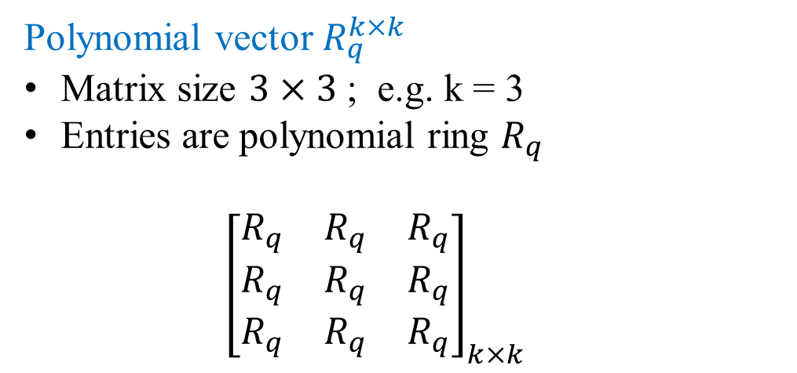
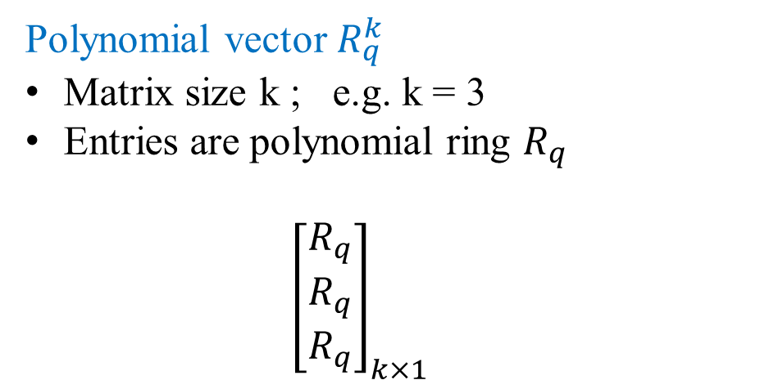
Polynomial vector $R_{q}^{k}$
Matrix size k ; e.g. k = 3
Entries are polynomial ring $R_{q}$
$${\left[\begin{aligned}R_{q} \\ R_{q} \\ R_{q}\end{aligned}\right]}_{k×1}$$
Polynomial vector $R_{q}^{k×k}$
Matrix size $3×3$ ; e.g. k = 3
Entries are polynomial ring $R_{q}$
$${\left[\begin{matrix}R_{q} & R_{q} & R_{q} \\ R_{q} & R_{q} & R_{q} \\ R_{q} & R_{q} & R_{q}\end{matrix}\right]}_{k×k}$$
$$R_{q}=a_{0}+a_{1}x+…+a_{n−1}x^{n−1}$$

Slide 11
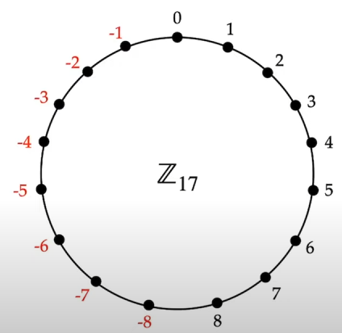
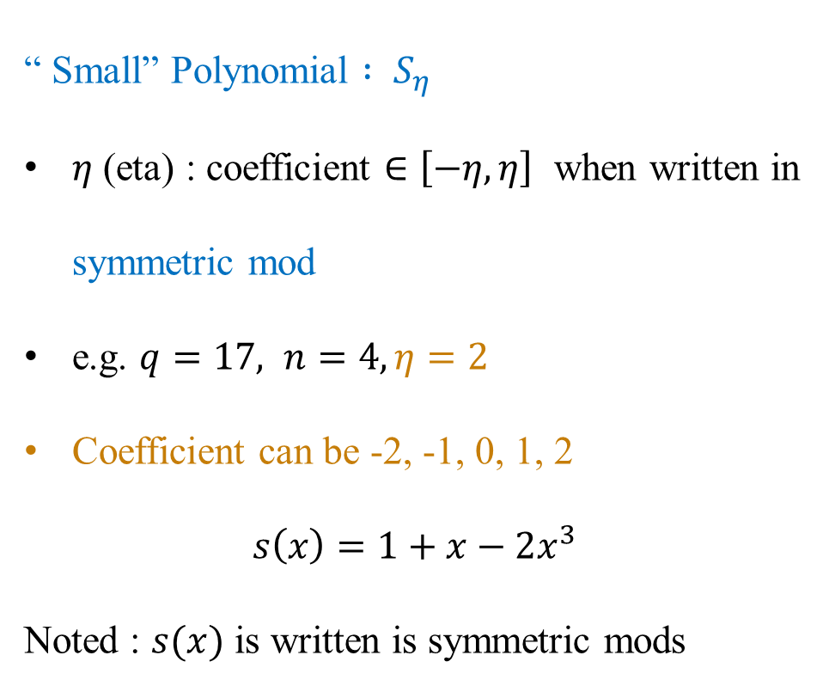


“ Small” Polynomial $: S_{η}$
$η$ (eta) : coefficient $∈\left[−η,η\right]$ when written in symmetric mod
e.g. $q=17, n=4, η=2$
Coefficient can be -2, -1, 0, 1, 2
$$s\left(x\right)=1+x−2x^{3}$$
Noted : $s(x)$ is written is symmetric mods
Symmetric mod → mods
$$(q−1)/2$$
$$15x^{3}$$

Slide 12
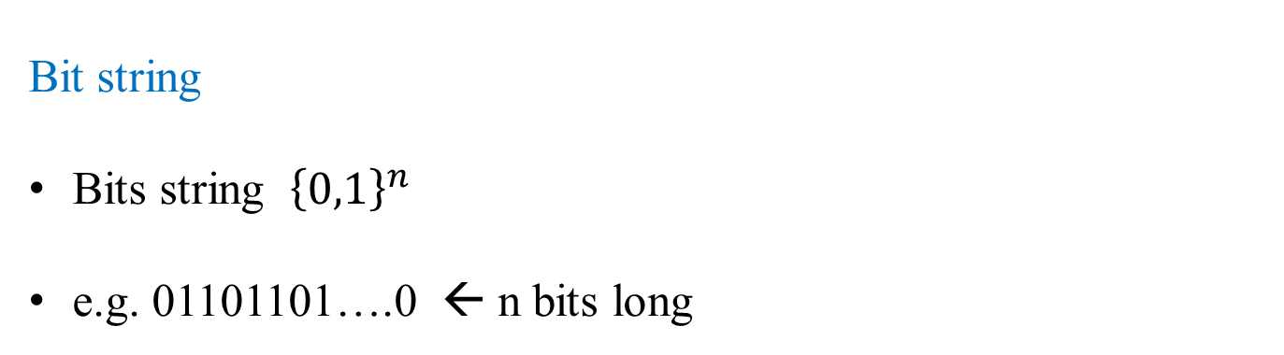
Bit string
Bits string ${\left\{0,1\right\}}^{n}$
e.g. 01101101….0 ← n bits long

Slide 13

Kyber-768 domain Parameters
$q=3329$ Polynomial coefficient can be : 0,1,2,…3328
$n=256$ Each polynomial has degree 255 : $a_{0}+a_{1}x+…+a_{255}x^{255}$
$k=3$ For matrix size
$η_{1}=2$ size of “small” polynomial
$η_{2}=2$ size of “small” polynomial
$d_{u}=10$ for compression/decompression of ciphertext
$d_{v}=4$ for compression/decompression of ciphertext

Slide 14
Kyber-pke
Base on Learning with errors problem
Public key encryption
Security level : “secure against chosen plain text attack” → lower than Kyber-KEM
Key generation
Encryption
Decryption
Hash function: generate A : SHAKE 128

Slide 15
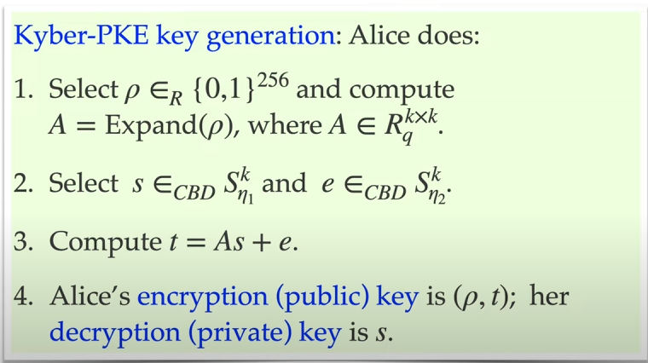
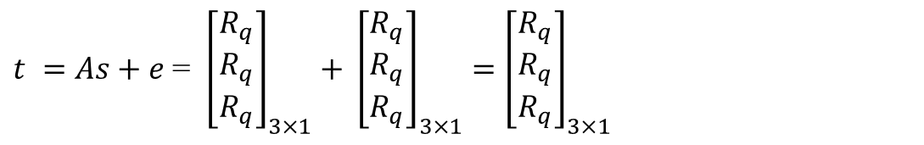
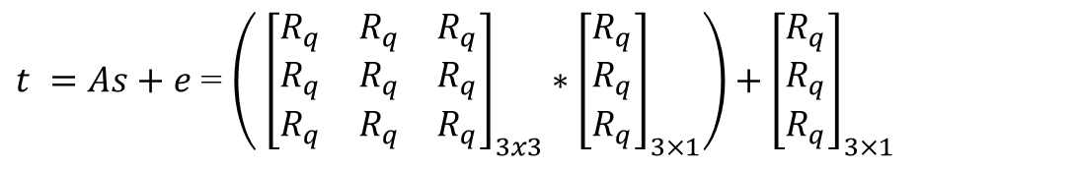



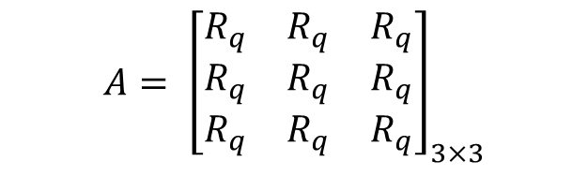
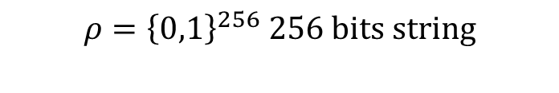

1
$$ρ={\left\{0,1\right\}}^{256} 256 bits string$$
A = Hash($ρ$)
$$A= {\left[\begin{matrix}R_{q} & R_{q} & R_{q} \\ R_{q} & R_{q} & R_{q} \\ R_{q} & R_{q} & R_{q}\end{matrix}\right]}_{3×3}$$
2
$s={\left[\begin{aligned}R_{q} \\ R_{q} \\ R_{q}\end{aligned}\right]}_{3×1} e={\left[\begin{aligned}R_{q} \\ R_{q} \\ R_{q}\end{aligned}\right]}_{3×1}$
Note : coefficient size has to be small according to $η_{1}=2$ , $η_{2}=2$
3
$t =As+e$ = $\left( {\left[\begin{matrix}R_{q} & R_{q} & R_{q} \\ R_{q} & R_{q} & R_{q} \\ R_{q} & R_{q} & R_{q}\end{matrix}\right]}_{3x3}∗{\left[\begin{aligned}R_{q} \\ R_{q} \\ R_{q}\end{aligned}\right]}_{3×1}\right)+{\left[\begin{aligned}R_{q} \\ R_{q} \\ R_{q}\end{aligned}\right]}_{3×1}$
$t =As+e$ = ${ \left[\begin{aligned}R_{q} \\ R_{q} \\ R_{q}\end{aligned}\right]}_{3×1}$ $+ {\left[\begin{aligned}R_{q} \\ R_{q} \\ R_{q}\end{aligned}\right]}_{3×1}={\left[\begin{aligned}R_{q} \\ R_{q} \\ R_{q}\end{aligned}\right]}_{3×1}$
As e t
A s e

Slide 16
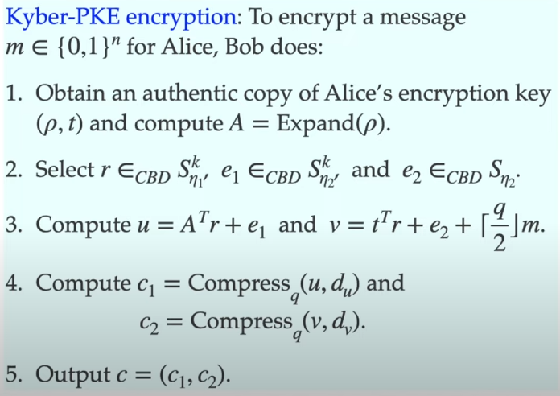
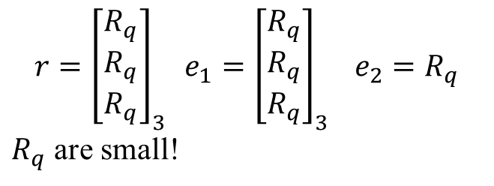
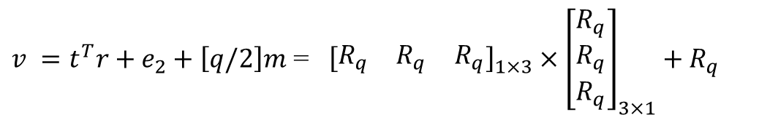

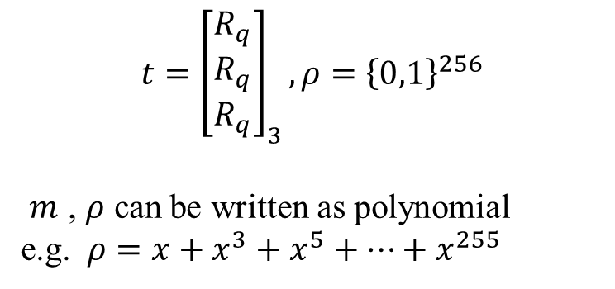

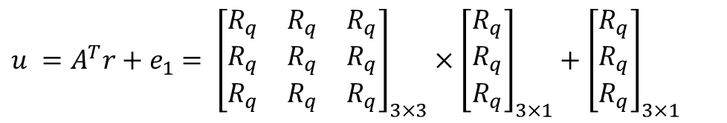


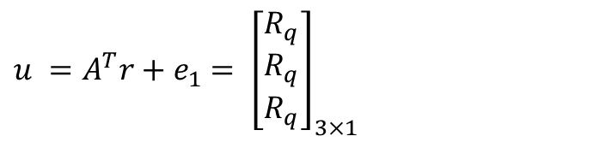
1
$$m={\left\{0,1\right\}}^{256}$$
$${t=\left[\begin{aligned}R_{q} \\ R_{q} \\ R_{q}\end{aligned}\right]}_{3}, ρ={\left\{0,1\right\}}^{256}$$
$m$ , $ρ$ can be written as polynomial
e.g. $ρ=x+x^{3}+x^{5}+…+x^{255}$
2
$$r={\left[\begin{aligned}R_{q} \\ R_{q} \\ R_{q}\end{aligned}\right]}_{3} e_{1}={\left[\begin{aligned}R_{q} \\ R_{q} \\ R_{q}\end{aligned}\right]}_{3} e_{2}=R_{q}$$
$R_{q}$ are small!
Ciphertext: send to Alice
3
$u =A^{T}r+e_{1}$ $= {\left[\begin{aligned}R_{q} \\ R_{q} \\ R_{q}\end{aligned}\right]}_{3×1}$
$u =A^{T}r+e_{1}$ $= {\left[\begin{matrix}R_{q} & R_{q} & R_{q} \\ R_{q} & R_{q} & R_{q} \\ R_{q} & R_{q} & R_{q}\end{matrix}\right]}_{3×3}×{\left[\begin{aligned}R_{q} \\ R_{q} \\ R_{q}\end{aligned}\right]}_{3×1}+{\left[\begin{aligned}R_{q} \\ R_{q} \\ R_{q}\end{aligned}\right]}_{3×1}$
$v =t^{T}r+e_{2}+\left[q/2\right]m$ = ${ \left[\begin{matrix}R_{q} & R_{q} & R_{q}\end{matrix}\right]}_{1×3} ×{\left[\begin{aligned}R_{q} \\ R_{q} \\ R_{q}\end{aligned}\right]}_{3×1}+R_{q}$
$v =t^{T}r+e_{2}+\left[q/2\right]m=R_{q}$
$A^{T}$ r ${ e}_{1}$
$t^{T}$ e t

Slide 17
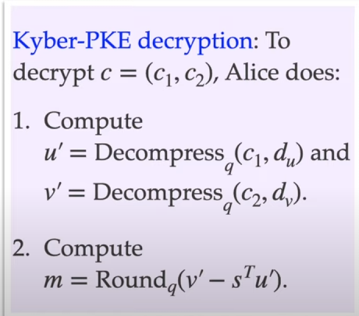
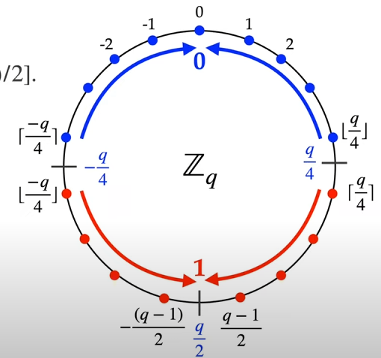




1
$u^{′}= {\left[\begin{aligned}R_{q} \\ R_{q} \\ R_{q}\end{aligned}\right]}_{3×1}$ , $v^{′}=R_{q}$
2
$m=Round_{q}\left(v^{′}−s^{T}u^{′}\right)$
$={Round_{q}( R}_{q}−$ ${ \left[\begin{matrix}R_{q} & R_{q} & R_{q}\end{matrix}\right]}_{1×3}×{\left[\begin{aligned}R_{q} \\ R_{q} \\ R_{q}\end{aligned}\right]}_{3×1})$
$={Round_{q}( R}_{q})$ → get plaintext
Note: there is small chance that decryption fail but the probability is very low
Bob’s original message
Rounding

Slide 18
Kyber-KEM
Kyber PKE alone is not secure enough. Applying “Fujisaki Okamoto” transform → Kyber KEM
Key Encapsulation mechanism
Using Kyber-PKE as base building block
Use Hash() and seed to create Pseudo RNG alongside
pure random
Central binomial Distribution
Security : “Secure against chosen ciphertext attack” ( more secure than Kyber-PKE)
Key generation
Encapsulation
Decapsulation
Hash function:
generate A : SHAKE 128
G is SHA3-512, H is SHA3-256, J is SHAKE256

Slide 19
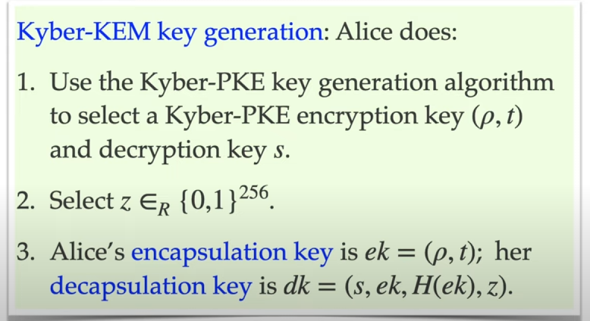






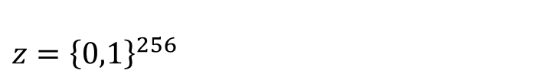




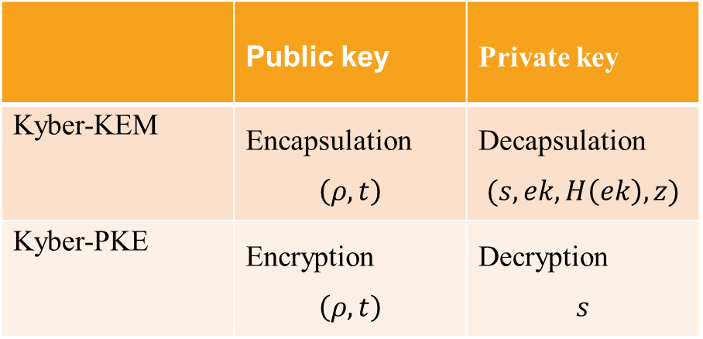


Follow Kyber-PKE Key-gen (page 15)
$ρ={\left\{0,1\right\}}^{256}$ $,t={\left[\begin{aligned}R_{q} \\ R_{q} \\ R_{q}\end{aligned}\right]}_{3×1}$
$s=$ ${\left[\begin{aligned}R_{q} \\ R_{q} \\ R_{q}\end{aligned}\right]}_{3×1}$
encryption key $ek=\left(ρ,t\right)$
1
2
 | Public key | Private key
Kyber-KEM | Encapsulation $$\left(ρ,t\right)$$ | Decapsulation $$(s,ek,H\left(ek\right),z)$$
Kyber-PKE | Encryption $$\left(ρ,t\right)$$ | Decryption $$s$$
$z={\left\{0,1\right\}}^{256}$
Encapsulation key = Encryption key
Decapsulation key != Decryptionkey

Slide 20
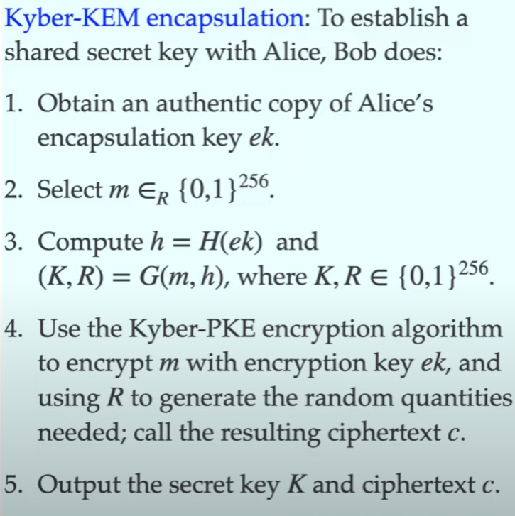



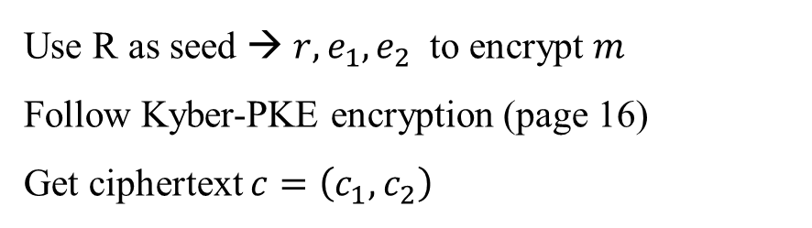




1
$ek=\left(ρ,t\right)$
2
$m=11000101…1$ ← 256 bits
Using hash function H and G
$K=11000101…1$ ← 256 bits string
$R=11000101…1$ ← 256 bits string
K is secret key
R is seed for Kyber-PKE step 4
3
4
Use R as seed → $r,e_{1},e_{2}$ to encrypt $m$
Follow Kyber-PKE encryption (page 16)
Get ciphertext $c=\left(c_{1}, c_{2}\right)$
Send ciphertext c to Alice

Slide 21
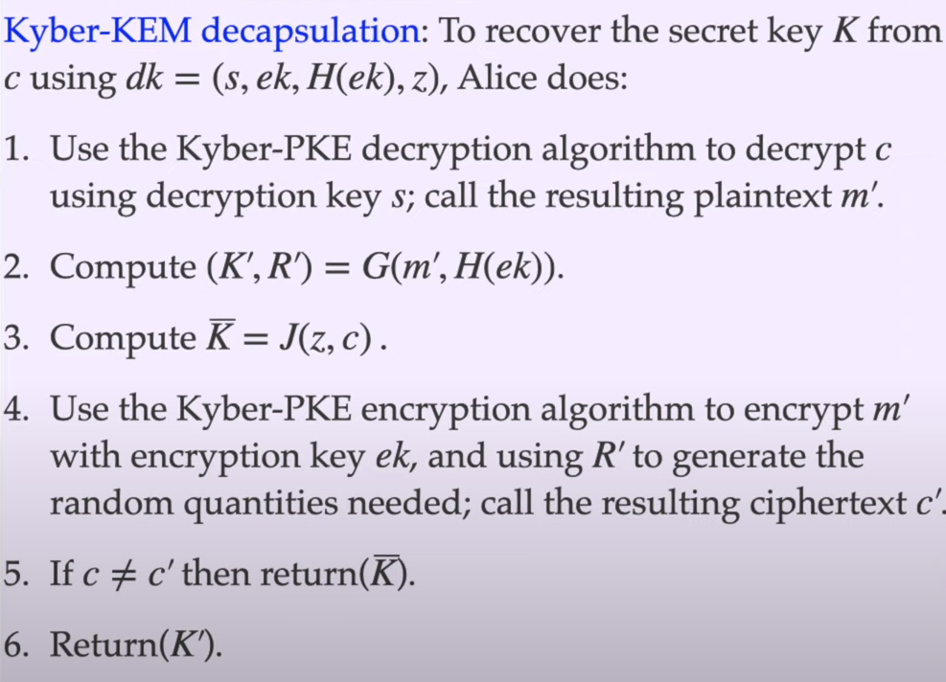


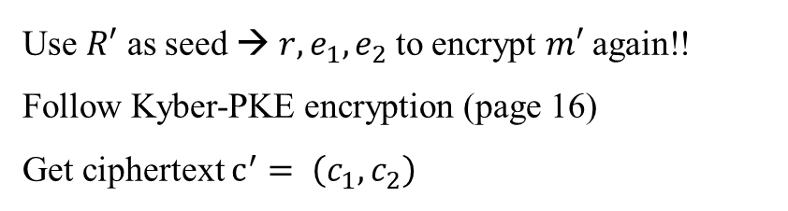


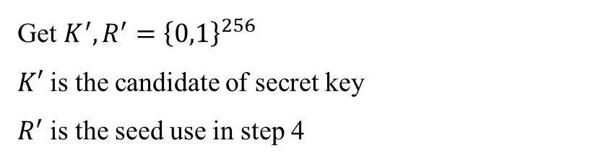



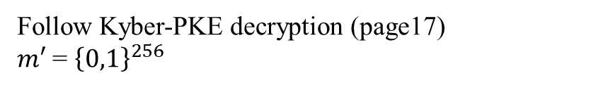

1
Follow Kyber-PKE decryption (page17)
$m′$ = ${\left\{0,1\right\}}^{256}$
Get $K^{′}, R^{′}={\left\{0,1\right\}}^{256}$
$K′$ is the candidate of secret key
$R^{′}$ is the seed use in step 4
2
3
$\overline{K}$ is return value when the decapsulation fail
Decapsulation fail
4
Use $R′$ as seed → $r,e_{1},e_{2}$ to encrypt $m′$ again!!
Follow Kyber-PKE encryption (page 16)
Get ciphertext $c^{′}= \left(c_{1}, c_{2}\right)$
Decapsulation successful

Slide 22
Future work
Literature review : implementation methods of Kyber KEM
Which part of algorithm have been implemented
Which part we could implement, and benefits?
Next presentation : Kyber KEM implementation on FPGA using High Level Synthesis tools

Slide 23
References
https://eee.poriyaan.in/topic/fpga--field-programmable-gate-arrays--11689/
https://www.researchgate.net/figure/Digital-circuit-with-two-inputs-OR-and-AND-gates_fig11_309907692
https://cryptography101.ca/kyber-dilithium/

